Slide 1
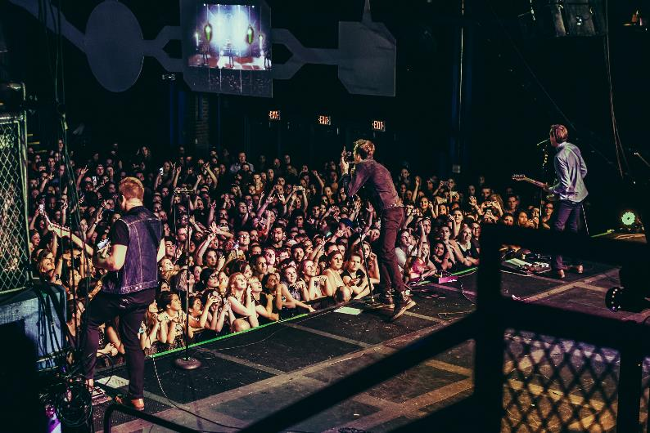
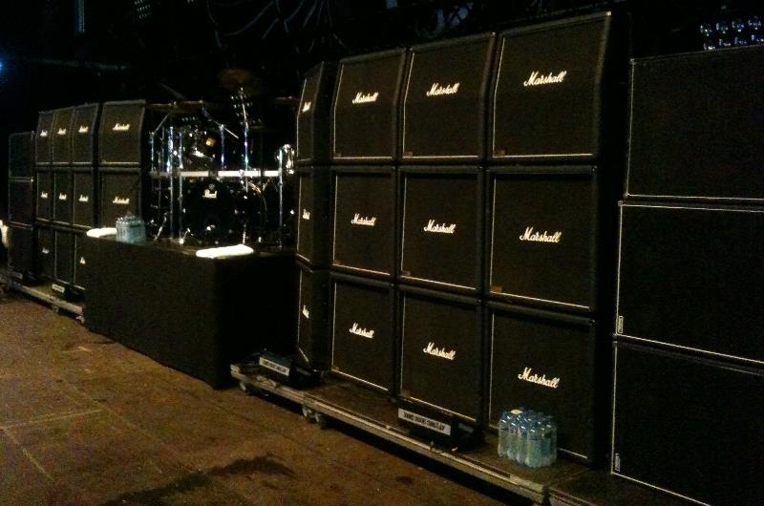
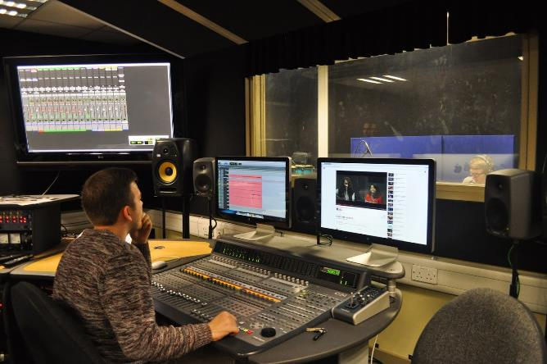
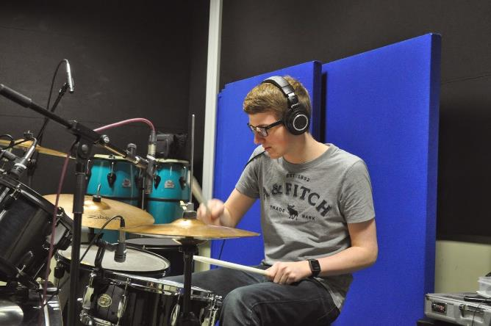
Effective use of foldback
1 | 2 | 3 | 4 | 5 | 6 | 7 | 8 | 9 | 10 | 11 | 12 | 13 | 14 | 15
Notes:
Hello
Practices & Principles
Live and studio overlap, share
Backline – Room acoustics – tempo and tune
Foldback delivers a precise mix – help perform at peak, optimum
Effective Techniques
1st Technoligies

Slide 2
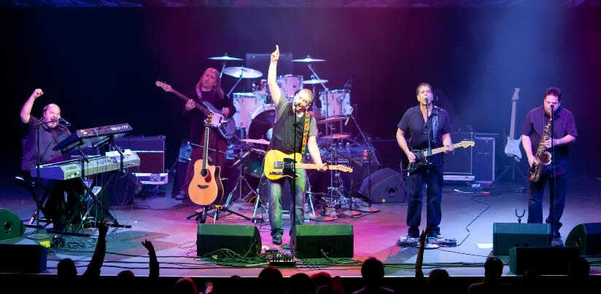
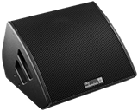
Floor Wedges
effective use of foldback - Technology
Advantages | Disadvantages
Cheap Easy to use Common | Loudness wars Spill High Stage Volume
1 | 2 | 3 | 4 | 5 | 6 | 7 | 8 | 9 | 10 | 11 | 12 | 13 | 14 | 15
Notes:
Floor Wedges:
Speaker on the floor
Wedge shape
Cheap - £100-£200 on Thomann
Compared to IEM - ~£300 pack and £100-£900 for good earbuds
Most common - Sound engineers know
Disadvantages – Spill, multiple
Loudness wars
On stage volume - FOH

Slide 3
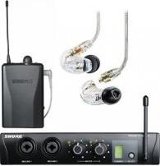
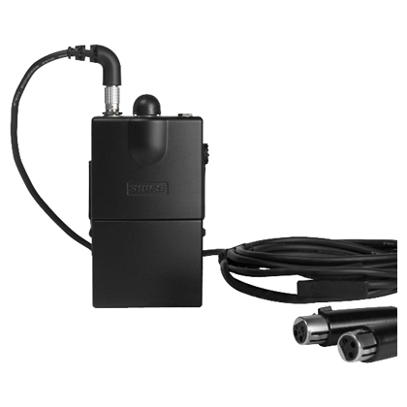
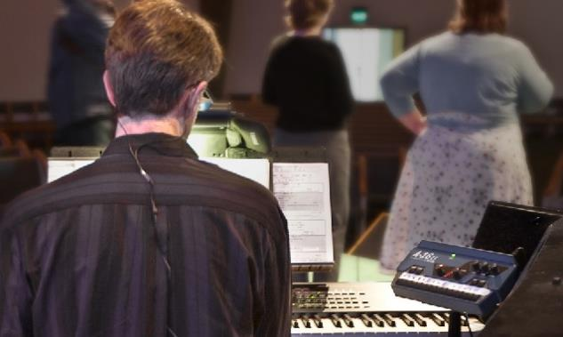
IEM’s
effective use of foldback - technology
Advantages | Disadvantages
Personal mix Sound Isolation Silent Rehearsals More discreet | Expensive Communication Risk of hearing damage Dynamic Range
1 | 2 | 3 | 4 | 5 | 6 | 7 | 8 | 9 | 10 | 11 | 12 | 13 | 14 | 15
Notes:
IEM’s:
Personal Mix
Sound Isolation – talking requires mic.
Silent Rehearsal – Shared space
Expensive – moulded earbuds = £100 - £1000
Discreet, in ears
Lower on-stage volume
Disadvantages - Not great bass response
Hearing damage - Dynamic range low

Slide 4
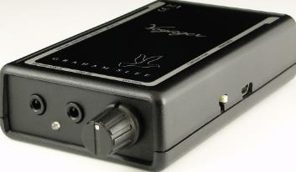
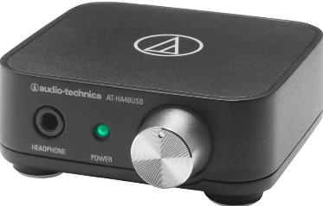
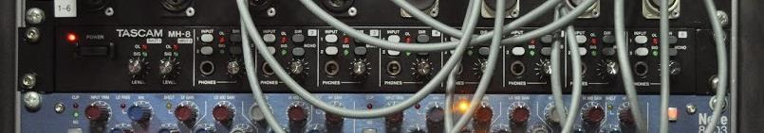
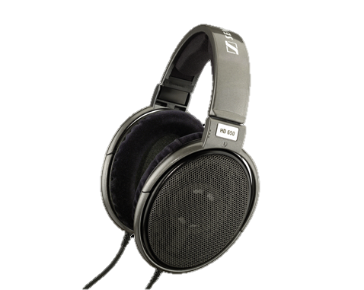
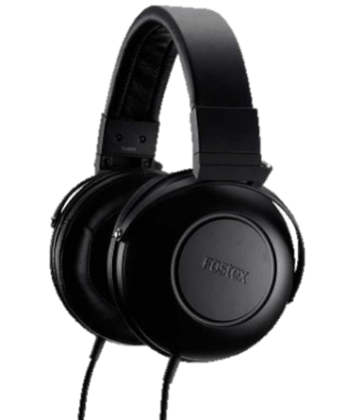
Headphone Amplifiers
effective use of foldback - technology
Advantages | Disadvantages
Personal mix Can power multiple headphones Can provide lots of power to headphones Better Frequency Response | No/Low Spill Latency due to ADC and DAC Impedance matching
1 | 2 | 3 | 4 | 5 | 6 | 7 | 8 | 9 | 10 | 11 | 12 | 13 | 14 | 15
Notes:
Headphone Amplifiers:
Personal Mix
Better frequency response than IEMs
Two types of headphones:
Open Back headphones – Hear room acoustics, hear people talking to you
Closed back headphones – No/low spill
Match impedances
Higher impedance, more on one amp
Less power from amp, less heat distortion
Low impedance = better volume but more current
Digital Conversion = latency

Slide 5
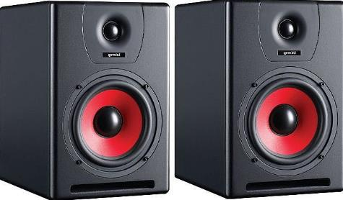
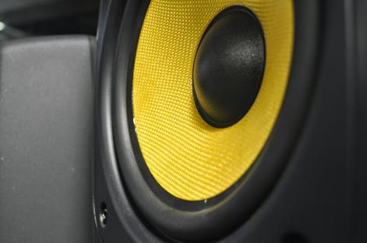
Studio monitors
effective use of foldback - technology
Advantages | Disadvantages
Size of Woofer Best EQ for mixing and mastering | Room acoustics Expensive Latency
1 | 2 | 3 | 4 | 5 | 6 | 7 | 8 | 9 | 10 | 11 | 12 | 13 | 14 | 15
Notes:
Studio Monitors:
Better Frequency response
Dedicated woofer and tweeter
Expensive – Reference, separate Sub
Room acoustics, Placement & design of studio is important
Going to talk about methods of mixing foldback….

Slide 6
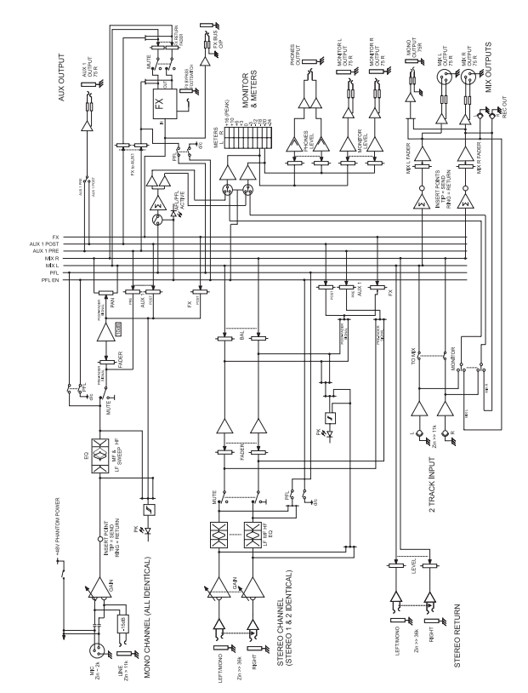
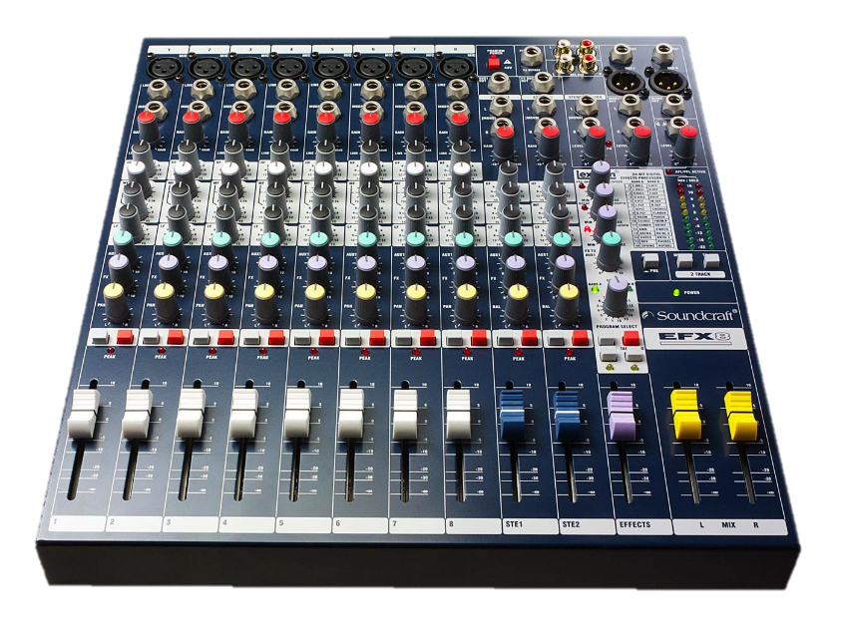
auxiliary sends
effective use of foldback - Analogue v digital
Bus
Individual Channels
Pre/Post Fade
1 | 2 | 3 | 4 | 5 | 6 | 7 | 8 | 9 | 10 | 11 | 12 | 13 | 14 | 15
Notes:
Auxiliary Send:
Aux Mix, Aux bus, Aux Send
Block diagram, this desk:
Sent to bus, summed, output
Individual channel mixes
Pre/Post Fade
Pre fade – instruments, fader doesn’t change mix, only gain
Post fade – mp3 player or laptop, fader changes mix volume & FOH

Slide 7
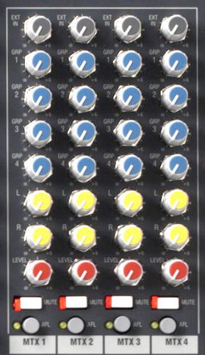
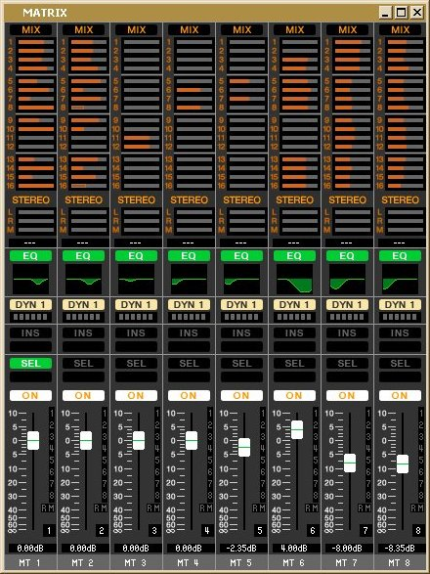
Matrix
effective use of foldback - Analogue v digital
Mix of Mixes
Similar to Buses in DAW
Pre Mixes for IEM’s
Audio Zones for Wedges
1 | 2 | 3 | 4 | 5 | 6 | 7 | 8 | 9 | 10 | 11 | 12 | 13 | 14 | 15
Notes:
Matrix:
Mix of Mixes
Similar to a bus except inputs are mixes not channels
Analogue – Allen & Heath GL2400
Digital - Windows Interface Yamaha LS9
Shure recommended pre mixes - ‘Full Band’, ‘Vocal Mix’, ‘Tune Mix’, ‘Beat Mix’
Loudspeaker management of wedges

Slide 8
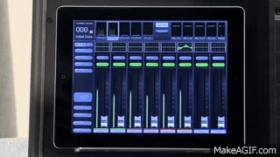
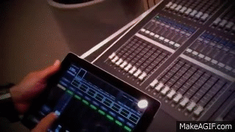
Companion Applications
effective use of foldback - Analogue v digital
Better User Interface
Control Surface
Mix from stage
Performers can mix their own mix
1 | 2 | 3 | 4 | 5 | 6 | 7 | 8 | 9 | 10 | 11 | 12 | 13 | 14 | 15
Notes:
Stagemix:
Same wireless network
Different User Interface
Control surface for desk
Mix wedges on stage
Talk to performers about wedges or IEM’s
Tech savvy can mix own mix from stage

Slide 9
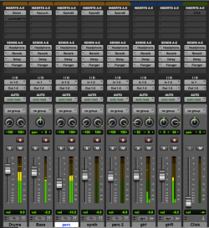
Digital Audio workstations
effective use of foldback - Analogue v digital
Infinitely flexible
Buses
Aux mixes
Direct outs
Stereo or Mono
1 | 2 | 3 | 4 | 5 | 6 | 7 | 8 | 9 | 10 | 11 | 12 | 13 | 14 | 15
Notes:
DAW:
Most flexible
Buses, Aux mixes, Direct outs channels
Click and drag outputs
Easily switch between mono and stereo
Computer’s power is the limit
Mac Pro in recording studios
Next, considering what should be in the mix
What makes a good mix

Slide 10
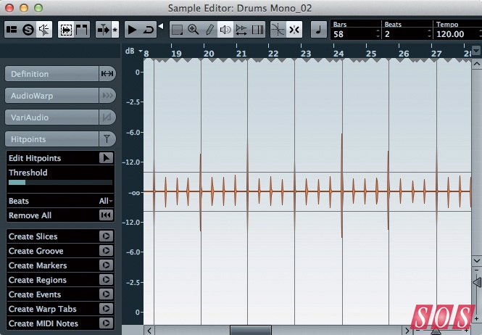
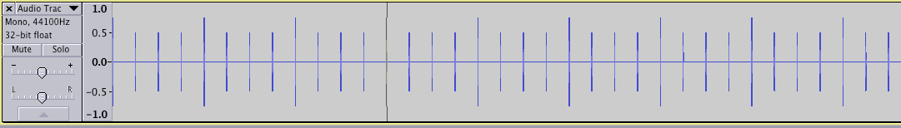
tempo
effective use of foldback - Mixing
Kick
Click
Music Direction
1 | 2 | 3 | 4 | 5 | 6 | 7 | 8 | 9 | 10 | 11 | 12 | 13 | 14 | 15
Notes:
Tempo:
Something to keep Tempo
Kick drum
Can fall off rhythm, velocity is not consistent, can’t hear
Song could be off-beat
Click track – digital metronome
Always consistent
On backing tracks, could include Music Direction

Slide 11
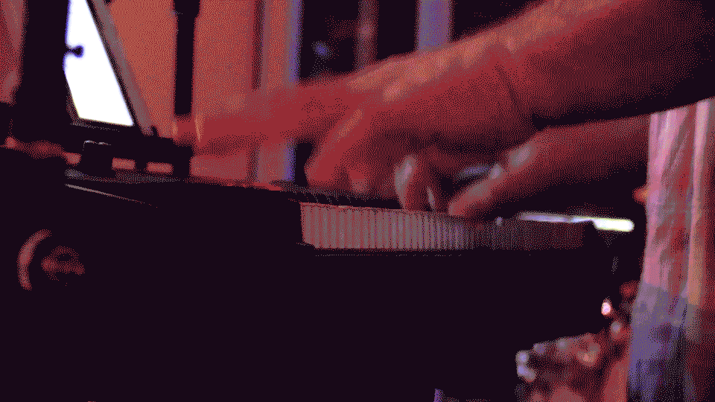
tune
effective use of foldback - mixing
Dominant instrument
Instrument that stays on tune
1 | 2 | 3 | 4 | 5 | 6 | 7 | 8 | 9 | 10 | 11 | 12 | 13 | 14 | 15
Notes:
Tune:
Something to keep in Tune
Dominant instrument
Piano, Acoustic Guitar – always playing tune
Not Electric which might be playing harmony
Next, looking at other aspects of the mix

Slide 12
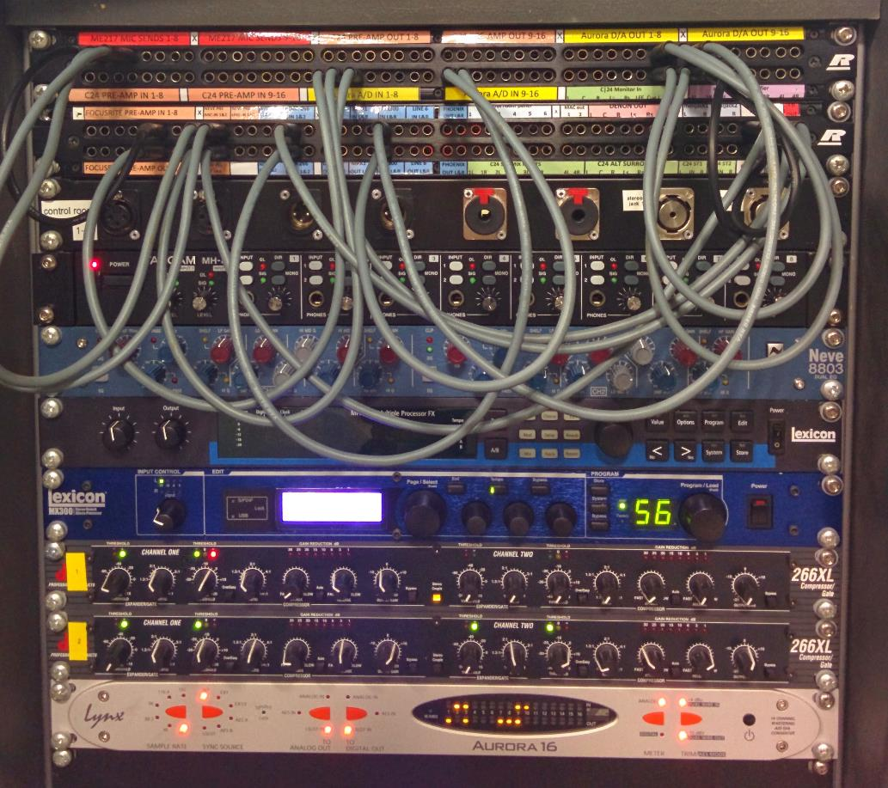
talkback
effective use of foldback - mixing
Cue Mix
Ducking
On top of mix
1 | 2 | 3 | 4 | 5 | 6 | 7 | 8 | 9 | 10 | 11 | 12 | 13 | 14 | 15
Notes:
Talkback:
Talkback aid front to back communication
Talkback is not part of the mix, it is on top.
Studio 2 – Mix > Cue mix (TalkBack added) > Headphone Amp/Output
Ducking, like on radio
Because ontop - Volume is same,
Different pack/Wedge volumes = different volume of TB

Slide 13
effects
effective use of foldback - mixing
Delay
Reverb
1 | 2 | 3 | 4 | 5 | 6 | 7 | 8 | 9 | 10 | 11 | 12 | 13 | 14 | 15
Notes:
Effects:
Some performers want effects
Don’t like instantness of zero-latency, off-putting
Delay of ~10ms to mimic speakers
Reverb makes sound softer and fuller – easier to sing
Masks tuning - hard to pitch

Slide 14
Safety
effective use of foldback - mixing
Hearing Damage
SPL
Limiters
Brick wall Limiters
1 | 2 | 3 | 4 | 5 | 6 | 7 | 8 | 9 | 10 | 11 | 12 | 13 | 14 | 15
Notes:
Safety:
Careful when mixing
Performer’s career depends on their hearing
Wedge & IEM’s at same apparent volume…
…IEM’s higher SPL because they are in ear
Limiters – included in modern IEM’s
Can be overridden by turning pack up very loud
Brickwall limit, limits SPL

Slide 15
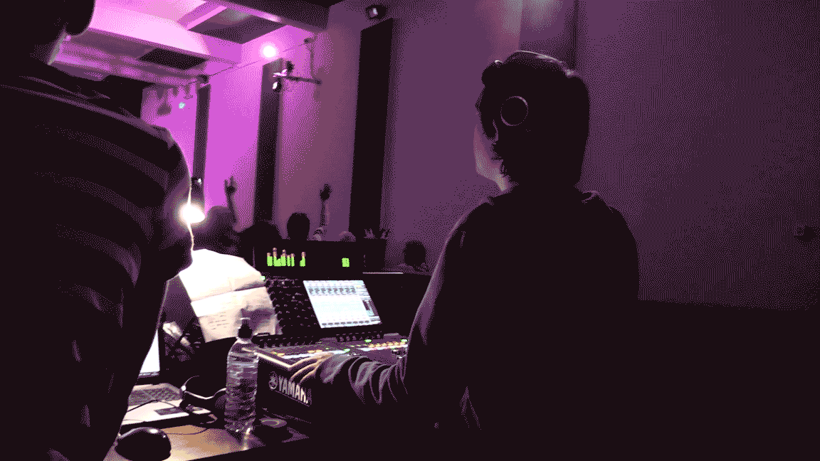
effective use of foldback - other
Different sized studios
Different sized stages
Personal Opinion
Psychoacoustics
Design of studio
1 | 2 | 3 | 4 | 5 | 6 | 7 | 8 | 9 | 10 | 11 | 12 | 13 | 14 | 15
Notes:
Discussion:
Other research
Bigger studios and stages, different acoustics
Mixes, personal opinion – interviews
No ‘right way’ to mix, however pre-defined patterns and best-practices
Psychoacoustics, volume same on meter, different perceived volumes
Quieter but fuller sound seems louder than loud thin sound
Foldback considered in design process – especially for studio monitors

